Slide 1

IST 565 Data Mining Week 6: Model Evaluation
Notes:
In the first five weeks we have learned several algorithms and build our first classification models. Now is a good time to look at a critical component in data mining, that is, the evaluation.

Slide 2
Model Evaluation
Topics:
Model overfitting
Model evaluation methods and metrics
Model comparison and selection
Reproducible research

Slide 3
Model Overfitting
Two fundamental concepts
Training error: train a model (e.g. a decision tree) on a training set, then test the model on the same training set. The error rate is called “training error”, which measures how well the model fits the training data.
Test error: test the model on a test set that is different from the training set. The error rate is called “test error”, which measures how well the model generalizes to new, unseen data.

Slide 4
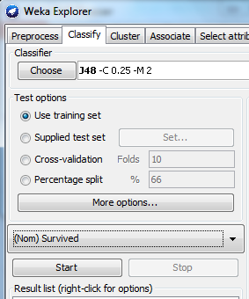
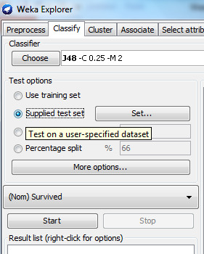
Training error vs. test error
Weka: the evaluation option to obtain training error
Weka: the evaluation option to obtain test error
Notes:
Move to separate segment on data formatting issues.
Make sure the training data and test data should use exactly the same format.
Weka is pretty picky on the format of csv files. Sometimes we humans view them as exactly the same format but Weka might complain incompatibility. In those cases, convert csv to Weka’s native arff format and see what the format difference is.

Slide 5
Model Overfitting
Overfitting means a model fits the training data very well, but generalizes to unseen data poorly.
Therefore, if the test error is much higher than training error, the model is more likely to be overfitting

Slide 6
Exercise
Post #nodes, training error and test error of your decision model for predicting Titanic survivors
Do you see signs of model overfitting?
Report your data preparation steps and parameter setting so that others can replicate your experiment

Slide 7
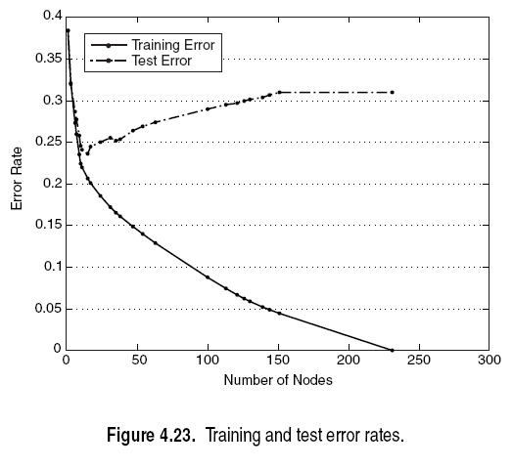
Model Complexity and Overfitting
Complex models are more likely to overfit than simple models
For decision tree, #nodes indicates model complexity.
more #nodes ->
higher model complexity ->
lower training error, and higher test error

Slide 9
Main reasons for model overfitting
Overfitting due to noise
Overfitting due to insufficient samples

Slide 10
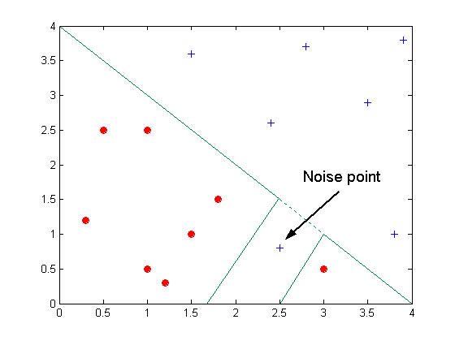
Overfitting due to Noise
The decision boundary (supposedly a straight line) is distorted by the noise point. The overfitted decision boundary is the solid blue lines.

Slide 11
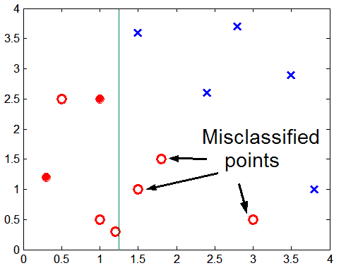
Overfitting due to Insufficient Examples
Blue crosses and solid red dots are training data.
Red circles are test data.
The green, vertical line is the decision boundary created by a simple decision tree (if x>1.25, label=blue; otherwise, label=read).
Lack of data points in the lower half of the diagram makes it difficult to predict correctly the class labels in that region.

Slide 12
Occam’s Razor
Given two models of similar generalization errors, the simpler model is preferred over the more complex model
For complex models, there is a greater chance that it was overfitted accidentally by errors in data or data inbalance.
Therefore, model complexity should be considered when evaluating a model
Notes:
principle

Slide 13
Exercise
Build the following decision tree models on the Titanic data
unpruned tree
Pruned tree
Report each model’ training error and test error. Describe whether overfitting occurs in the unpruned tree, and which model would you choose.

Slide 14
Model evaluation methods
What methods can measure model fitness before using it in real predictions?
Some evaluation methods have been designed to test the model on training data while controlling model overfitting.
Hold-out test
Cross validation

Slide 15
Hold-out test
Hold-out test
split the training data to two subsets, using one subset for training, and the other for testing.
The splitting ratio is determined by the training set size in that both subsets cannot be too small.
50/50 or 2:1 are common splitting ratios.
Advantage
Fast
Shortcoming
When the split changes, the test result changes too. High variability in the test result.

Slide 16
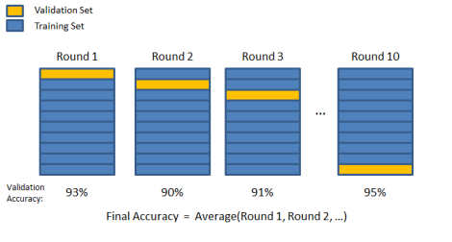
Cross Validation (CV)
N-fold Cross validation (CV)
N is determined by the training set size. The larger the N, the longer it takes to run the experiment.
5 or 10 are common choices for N.
http://chrisjmccormick.wordpress.com/2013/07/31/k-fold-cross-validation-with-matlab-code/
Notes:
Eventually we built 10 models and evaluated the average performance, more reliable, less variability.
Which model to use? You can choose one with best performance, or just re-train a final model on all training data. (most tools do that)

Slide 17
Leave One Out
An extreme case of cross validation
N equals the training set size S.
Advantage
No variability in the test result (always get the same result)
Problems
The most time-consuming method
Usually used on very small data sets

Slide 18
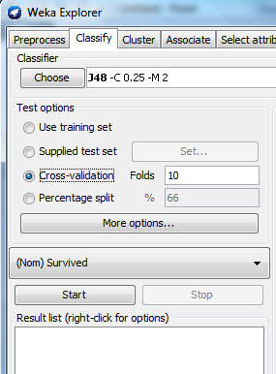
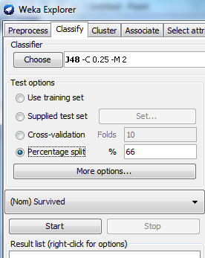
Hold-out Test vs. Cross Validation
Weka test opion for hold-out test
Weka test opion for cross validation

Slide 19
Hold-out Test vs. Cross Validation
Hold-out test
Pros: fast
Cons: high variability in the result depending on the split
Cross validation
Pros: less variability and thus more reliable error estimation
Cons: takes longer time
Notes:
Exercise: compare

Slide 20
Which model evaluation methods to choose?
CV is the standard method
When data set is huge, hold-out test can save time
When data set is small, leave-one-out can be considered

Slide 21
Exercise: compare variability in CV and hold-out test results
Use J48 and Titanic data, build a model, then do 5-fold CV five times. Each time, change random seeds to re-shuffle the data, e.g. choose random seeds as 10, then 20, 30, 40, 50. Report CV accuracy for each test
Then do 5 hold-out tests. Choose percentage split 80%, change the random seed in the same way, and report the accuracies
Now compare the variability by calculating average accuracy and standard deviation
hypothesis: hold-out test results have higher variability
Does your result support this hypothesis?

Slide 22
Metrics for model performance
Accuracy is the most common measure, but it has limitations, especially on skewed data set.
Data set with similar number of examples in each category is “balanced”, otherwise “unbalanced” or “skewed”
Titanic training data set is skewed with more negative examples than positive ones
549 “0”: did not survive
342 “1”: survived

Slide 23
Problem with accuracy measure
We need to learn some fundamental concepts first:
Confusion matrix for two classes (can be extended to multiple classes)
 | PREDICTED CLASS
ACTUAL CLASS |  | Class=Yes | Class=No
 | Class=Yes | a | b
 | Class=No | c | d
a: TP (true positive)
b: FN (false negative)
c: FP (false positive)
d: TN (true negative)

Slide 24
Accuracy definition based on confusion matrix
Most widely-used metric:
 | PREDICTED CLASS
ACTUAL CLASS |  | Class=Yes | Class=No
 | Class=Yes | a (TP) | b (FN)
 | Class=No | c (FP) | d (TN)

Slide 25
Limitation of Accuracy
Consider a 2-class problem
Number of Class 0 examples = 9990
Number of Class 1 examples = 10
If a model predicts every test example as “0”, the model’s accuracy is 9990/10000 = 99.9 %
Accuracy is misleading because the trivial model does not detect any class 1 example

Slide 26
Two types of error
Market analysis: to predict if a student is going to buy new computer or not.
Prediction result in a confusion matrix:
 | predictions
classes | buy_computer = yes | buy_computer = no | total
buy_computer = yes | 6000 | 1000 | 7000
buy_computer = no | 500 | 2500 | 3000
total | 6500 | 3500 | 10000
False positive: wrong targets
False negative: missed customers

Slide 27
Which type of error matters more?
For a company, one type of error might be more costly than the other.
Eg. One would rather send out more coupons than missing a potential buyer.
E.g. one would rather tolerate some junk mail in inbox than risking misclassify a regular mail to junk.
The accuracy measure does not differentiate these two types of errors, but precision and recall would do.

Slide 28
Precision and recall
Concepts borrowed from the information retrieval field.
Define precision and recall on each category
 | PREDICTED CLASS
ACTUAL CLASS |  | Class=Yes | Class=No
 | Class=Yes | a (TP) | b (FN)
 | Class=No | c (FP) | d (TN)

Slide 29
Precision
Meaning: among all positive predictions, how many are correct?
 | PREDICTED CLASS
ACTUAL CLASS |  | Class=Yes | Class=No
 | Class=Yes | a (TP) | b (FN)
 | Class=No | c (FP) | d (TN)

Slide 30
Recall
Meaning: among all positive examples, how many are correctly predicted?
 | PREDICTED CLASS
ACTUAL CLASS |  | Class=Yes | Class=No
 | Class=Yes | a (TP) | b (FN)
 | Class=No | c (FP) | d (TN)

Slide 31
Example: calculate precision and recall
 | predictions
classes | buy_computer = yes | buy_computer = no | total | recall(%)
buy_computer = yes | 6000 | 1000 | 7000 | 6000/7000
buy_computer = no | 500 | 2500 | 3000 | 2500/3500
total | 6500 | 3500 | 10000
Precision (%) | 6000/6500 | 2500/3500

Slide 32
F-measure
An ideal model would achieve high precision and recall on all categories
But in reality precision and recall are like the two sides of a see-saw: if one goes up, the other might go down
F-measure is a weighted average of precision and recall

Slide 33
Exercise: calculate F-measure
Can you calculate the F-measures for the following confusion matrix?
 | predictions
classes | buy_computer = yes | buy_computer = no | total | recall(%)
buy_computer = yes | 6000 | 1000 | 7000 | 6000/7000
buy_computer = no | 500 | 2500 | 3000 | 2500/3500
total | 6500 | 3500 | 10000
Precision (%) | 6000/6500 | 2500/3500

Slide 34
Baselines for Model Evaluation
If you classification model reached 80% accuracy, is it “good enough”?
Two common baselines for comparison
Random guess: if there are two categories, a model based on random guess would result in 50% accuracy.
Majority vote: if the data set is skewed, a trivial model would assign all test data to the larger category.
In the Titanic training data set, the majority vote model would result in 549/891=62% accuracy.
your model is expected to outperform the common baselines
Notes:
The measurement numbers do not directly tell us which model is “good enough”

Slide 35
Majority vote baseline
 | predictions
classes | buy_computer = yes | buy_computer = no | total | recall(%)
buy_computer = yes | 7000 | 0 | 7000 | 1
buy_computer = no | 3000 | 0 | 3000 | 0
total | 10000 | 0 | 10000
Precision (%) | .70 | na
Notes:
Prediction: everyone is going to get a new computer

Slide 36
Fair comparison
When comparing the performance of two models, e.g. an unpruned tree vs. a pruned tree, make sure the comparison is fair, meaning the test data should be exactly the same.
Common mistakes:
run hold-out test on one model, but cross validation on another model
Set up different numbers of folds for the two models when using cross validation
Set up different split ratio for the two models when using hold-out test

Slide 37
Other aspects of evaluation
When comparing two classification models, predictive capability (as measured by accuracy, precision, recall, etc.) is only one aspect to examine.
Other aspects
Speed
Robustness
scalability
Model interpretability

Slide 38
Other aspects of evaluation
Speed
time to construct model (training time)
time to use the model (classification/prediction time)
Robustness
handling noise and missing values
Scalability
the data set size keeps increasing
Interpretability
understanding the insight provided by the model
Notes:
Robustness: pruned trees are more robust than unpruned trees

Slide 39
Is the model good enough?
There is always room for improvement for non-trivial prediction tasks.
Evaluation from system perspective
Evaluation from user perspective

Slide 40
Exericse: model comparison
Are you satisfied with your email spam filter? Use terms like accuracy, precision and recall to explain the strength and weakness of the email spam filter that you are using. Rank the strength and weakness aspects based on their importance to you.

Slide 41
Training data size affects accuracy
Larger training data set usually helps improve the model, but not always
Data saturation
Noise in data
How many is “enough”?
Depends on many factors, e.g. data availability, cost to obtain data, data quality

Slide 42
Training data size affects accuracy
Larger training data set usually helps improve the model, but not always
Data saturation
Noise in data
How many is “enough”?
Depends on many factors, e.g. data availability, cost to obtain data, data quality

Slide 43
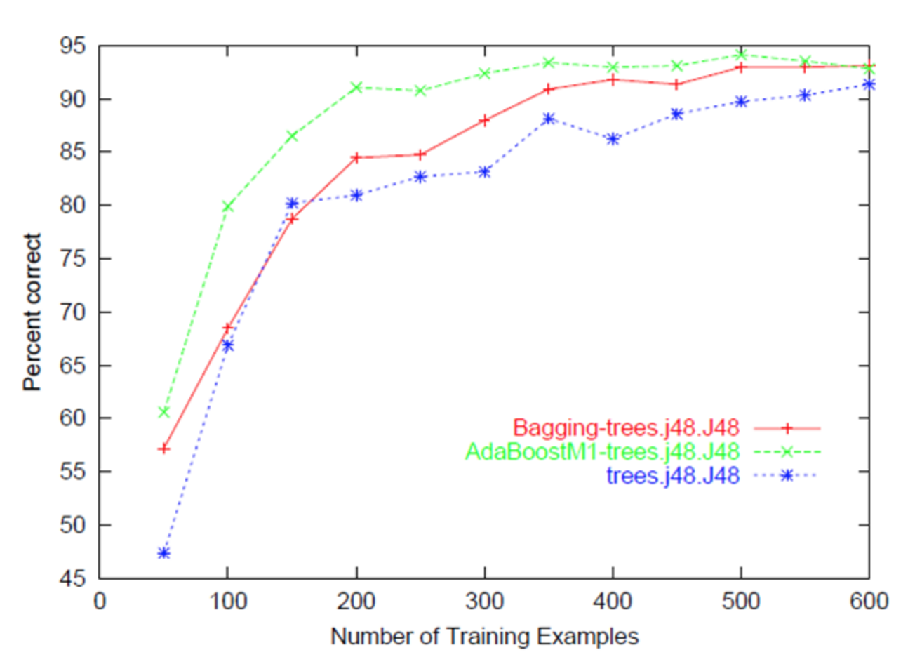
Learning curve
http://stackoverflow.com/questions/4617365/what-is-a-learning-curve-in-machine-learning
Notes:
Determine whether the training data set is large enough, meaning the curve shows plateau.

Slide 44
Exercise: training set size
Titanic: increase the percentage split from 10% to 20%, 30%, 40%, 50%, …, 90%
Does the accuracy increase?
Note this is not a precise learning curve because the test data also changed each round

Slide 45
Not enough data?
Semi-supervised learning
Active learning
Crowdsourcing

Slide 46
Semi-supervised learning
Utilize the strength of current model
Assume the most confident predictions are highly accurate
Process
Build model on current training data
Apply model to test data
Rank test data by prediction confidence.
Add the most confident ones into training data

Slide 47
Active Learning
Goal: adding data to reduce current model’s weakness
Also rank test data by prediction confidence
Choose the least confident ones
Confirm these predictions with human experts
Add them to training data
Notes:
In contrast, active learning focuses on the model’s weakness and how to acquire data to improve it

Slide 48

Crowdsourcing
Divide-n-conquer
ask many people to each label a few examples for you
Amazon Mechanical Turk

Slide 49
How trustworthy is human annotation?
Reliability test
If asking 2 or more people to mark the sentiment of a collection of tweets, to what extent will they agree with each other?

Slide 50
Subjectivity in Classification
Some classification tasks involve certain level of subjectivity in decision.
Whether a tweet is positive or neutral can be subjective decision.
Different people may annotate the same tweet with different labels, e.g. “positive”, “neutral”

Slide 51
A “polarized” coder

Slide 52
A “neutral” coder

Slide 53
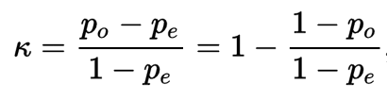
Inter-coder agreement
Measures to evaluate the reliability of human annotation
Percentage of agreement
Cohen’s Kappa
Po: observed agreement
Pe: chance of agreement

Slide 54
Inter-coder Agreement
Raw agreement:
a=count(agreed_items)/total_items
Problem with raw agreement:
Skewed categories: 90% raw agreement in both tables
 | Coder A
Coder B |  | Positive | negative
 | positive | 45 | 5
 | negative | 5 | 45
 | Coder A
Coder B |  | Positive | negative
 | positive | 90 | 10
 | negative | 0 | 0

Slide 55
Cohen’s kappa
a=raw_agreement
c=chance_agreement
K=(a-c)/(1-c)
 | Coder A
Coder B |  | Positive | negative
 | positive | 45 | 5
 | negative | 5 | 45
 | Coder A
Coder B |  | Positive | negative
 | positive | 90 | 10
 | negative | 0 | 0

Slide 56
Cohen’s kappa
a=raw_agreement
c=chance_agreement
K=(a-c)/(1-c)
K=0.8
K=0
 | Coder A
Coder B |  | Positive | negative
 | positive | 45 | 5
 | negative | 5 | 45
 | Coder A
Coder B |  | Positive | negative
 | positive | 90 | 10
 | negative | 0 | 0

Slide 57
How to calculate kappa?
Given a confusion matrix of two coders
 | Coder A
Coder B |  | Positive | negative
 | positive | 45 | 5
 | negative | 5 | 45

Slide 58
How to calculate kappa?
Calculate marginal distribution
 | Coder A
Coder B |  | Positive | negative
 | positive | 45 | 5 | 50%
 | negative | 5 | 45 | 50%
 |  | 50% | 50%

Slide 59
How to calculate kappa?
Calculate raw agreement ( a=0.9 )
Calculate
P(both A and B gives “positive” label) = 0.25
P(both A and B gives “negative” label) = 0.25
Chance_agreement: c=0.25+0.25=0.5
Kappa=(a-c)/(1-c)=(0.9-0.5)/(1-0.5)=0.4/0.5=0.8

Slide 60
Tools to calculate kappa
Online tool
http://vassarstats.net/kappa.html

Slide 61
Exercise: calculate kappa agreement?
 | Coder A
Coder B |  | Positive | negative
 | positive | 89 | 9
 | negative | 1 | 1
Notes:
Answer: .139
P(A=positive)*P(B=positive)=.90*.98
P(A=negative)*P(B=negative)=.10*.02
P_chance=.884

Slide 62
Exercise: MTurk
Answer the following questions through literature search
How is the quality of data acquired from MTurk?
What are the common concerns over MTurk?

Slide 63
Reproducible research
Reproducible research is a cornerstone of scientific research
Report your data mining approach and results in a reproducible way
Use tools like RMD to document the process
If possible, open data access

Slide 64
Exercise: reproducible research
Examine posts to Week 5 Forum: Weka J48 exercise
Try replicate the experiment in one post
Did you reach the same result?
If not, can you explain why?

